Slide 1
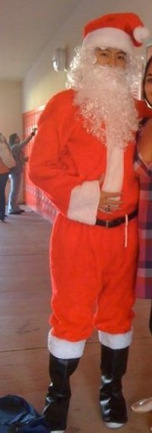



Alpha Phi Omega
Chi Chapter at UCLA
Alpha Mu / Kay Krenek Term, Meeting 8
December 10, 2014
www.apo-x.org

Slide 2
Agenda
1. Officer Updates and Announcements
2. Alpha Nu Nominations Part II
3. Namesake Nominations for Alpha Nu Term
4. Advisor Elections
5. Swear-In Advisors
6. Last Announcements

Slide 3
President
Raymond Mai
president@apo-x.org
Executive Committee
excomm@apo-x.org

Slide 4
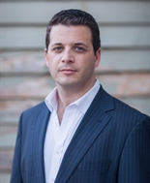
Personal Finance Workshops
Look at this good looking guy →
I’ve said this a million times!
SHAWN PATT
Morgan Stanley
First VP and Financial Advisor
2 Workshops
January 6th - Budgeting
January 15th - Loans/Debt
He is a trained professional, and we should take advantage! People pay for this service!

Slide 5

USAC Funds
Beginning of the term, I helped direct Finance VPs in applying for external sources of funding to be more fiscally responsible
We have $255.36 in our account!
Thinking about subsidizing banquet… YAH?!

Slide 6

Awards!!
We are a Chapter of Champions
Awards we’ve won this past school year
Chapter of Excellence (Blue Level)
Met requirements to be an exceptional chapter
Pledge Program of Excellence (Diamond Level)
Met requirements in having an exceptional pledge program
Joseph Scanlon Certificate of Merit
15%+ membership growth
Shoutout to past presidents Holly Fuong (AK) and Jessica Suhardjo (AL)!

Slide 7
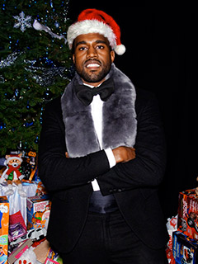

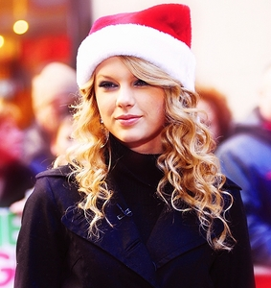
HAPPY HOLIDAYS AND GOOD LUCK ON FINALS!
Kanye West = The Greatest | Ari and TaySway = Baebaes

Slide 8
Administrative VPs
Kevin Quizon & Nicola Yip
admin@apo-x.org

Slide 9

Check out our Newsletter!
Thank you Jun, Sherry and, Selena!!

Slide 10

Good luck on finals!

Slide 11
MEMBERSHIP.
Jeremy Gozzip & Andrew Suh
membership@apo-x.org

Slide 12
Holiday Outfits!

Slide 13
CLass Highlights!
ALPHA THETA WILL BE AFTER BREAK CM9!
AΘ

Slide 14
Rush Makeups
1 missed hour of rush flyering = 2 hours of service
1 missed rush event = 2 friendships

Slide 15
Chapter Events!
Suggest a chapter event to happen after ski-trip and before banquet!

Slide 16
Service VP
Rui Guo
apoxservice@gmail.com

Slide 17

Blanket Making
Materials will be provided later this week!
Limit 2 per person. 2 hours of service per blanket
You are free to buy your own, but you will NOT be reimbursed
Supplies will be limited!

Slide 18

Good luck with finals!

Slide 19

Pledge Parents
Brian Lee & Emily Neai-Proeung
apoxpparents@gmail.com

Slide 20

Cool Shiet.

Slide 21
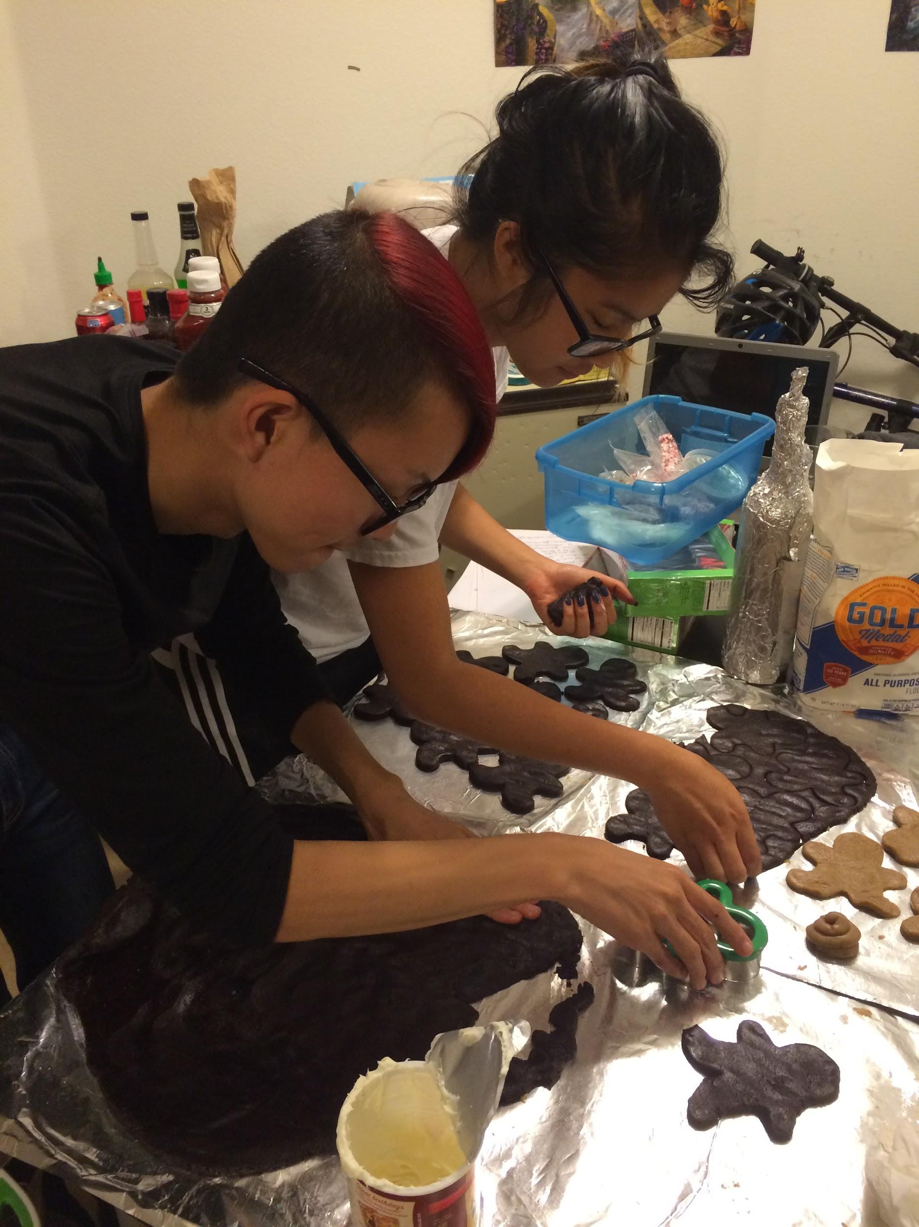
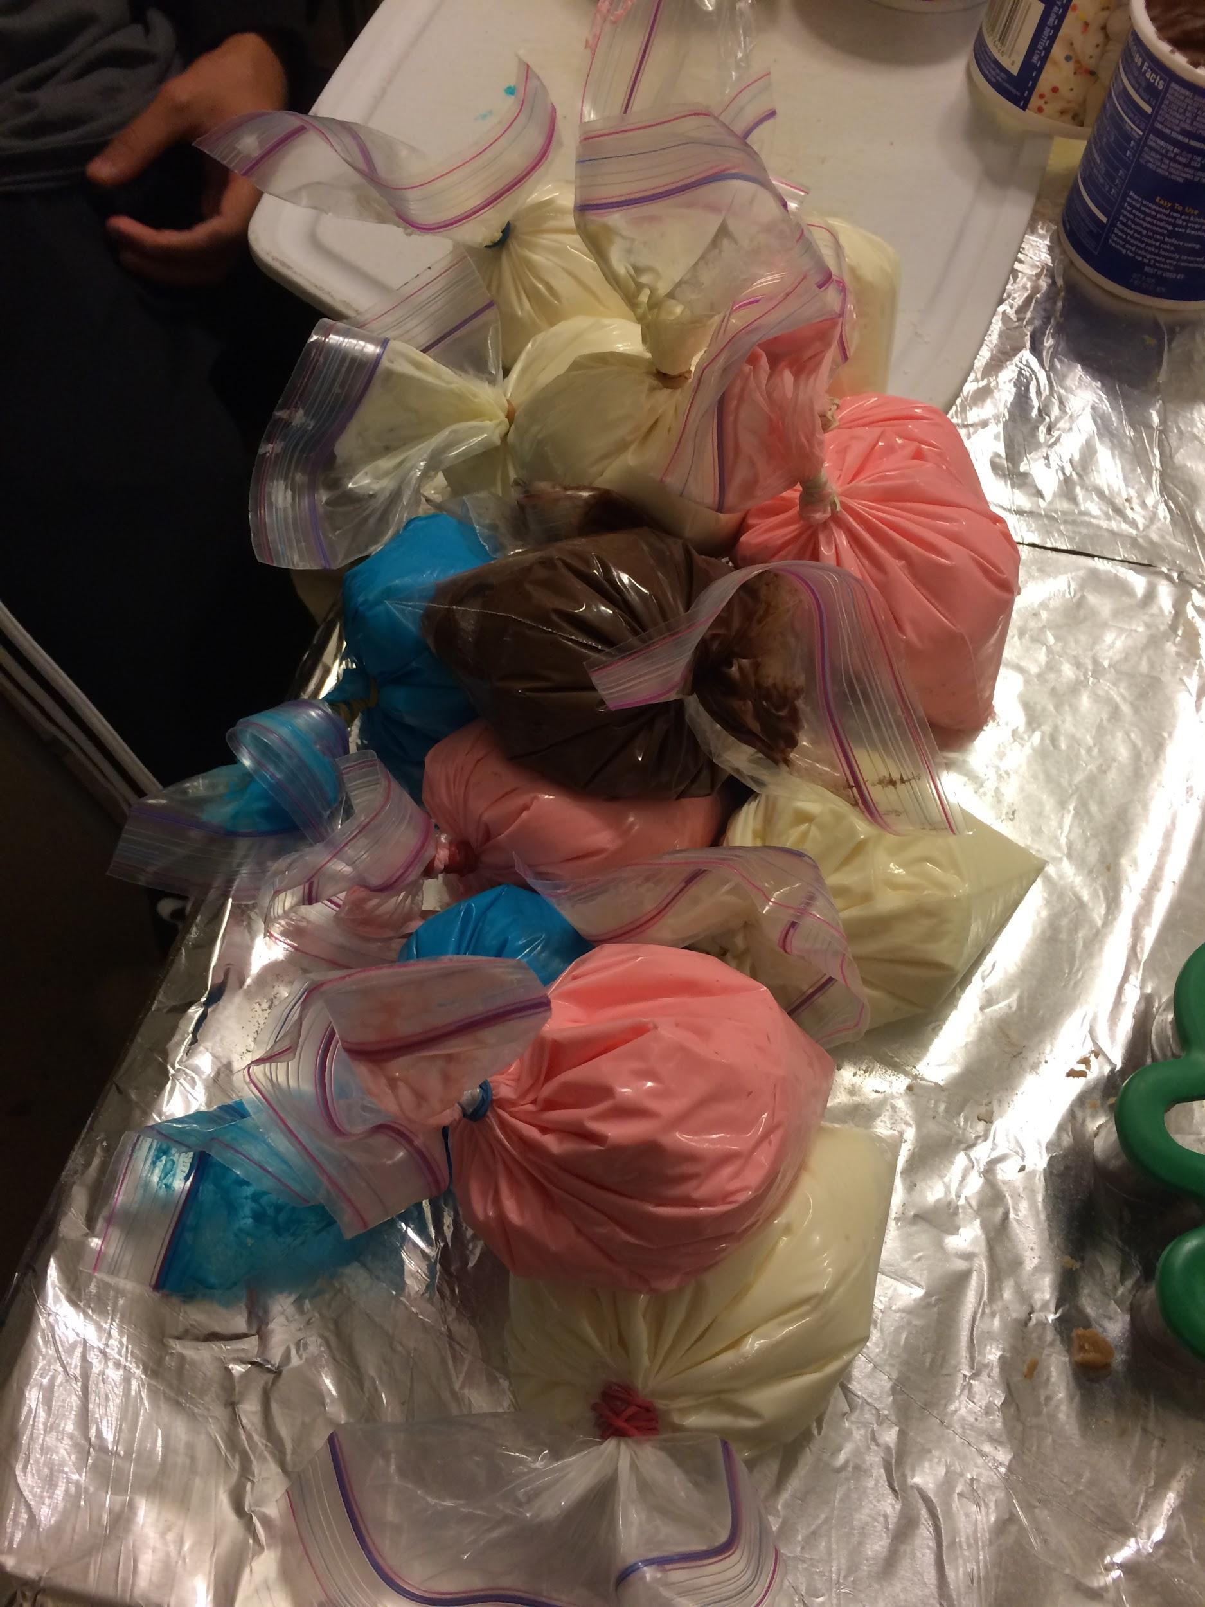
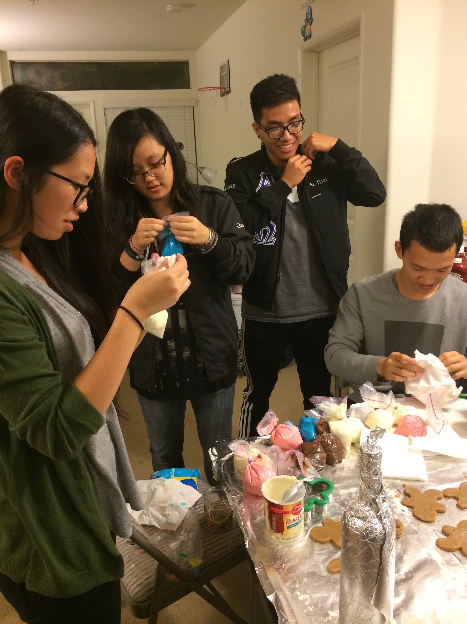

PAC Social

Slide 22
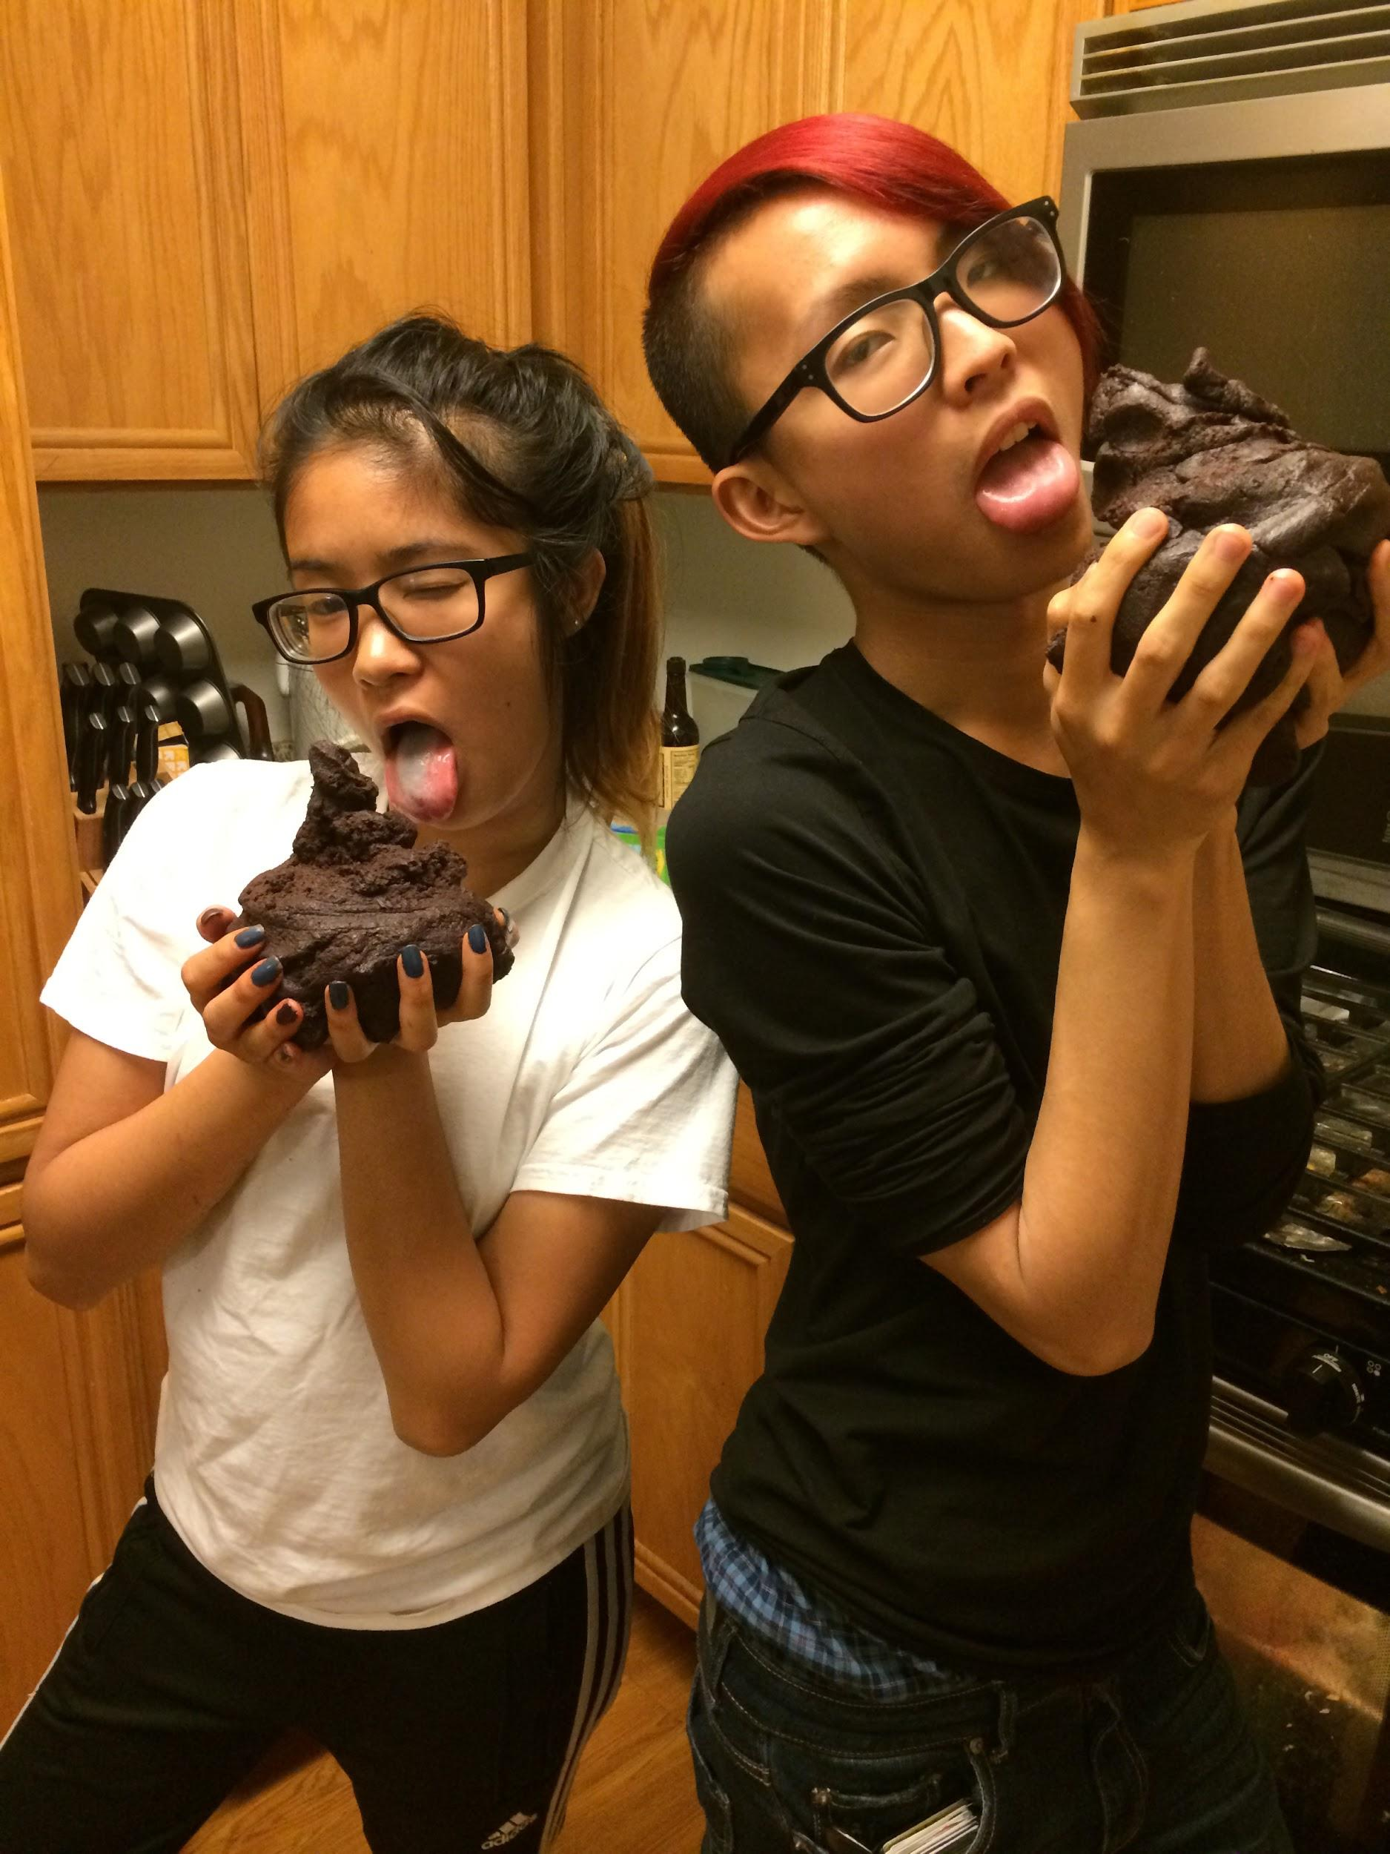
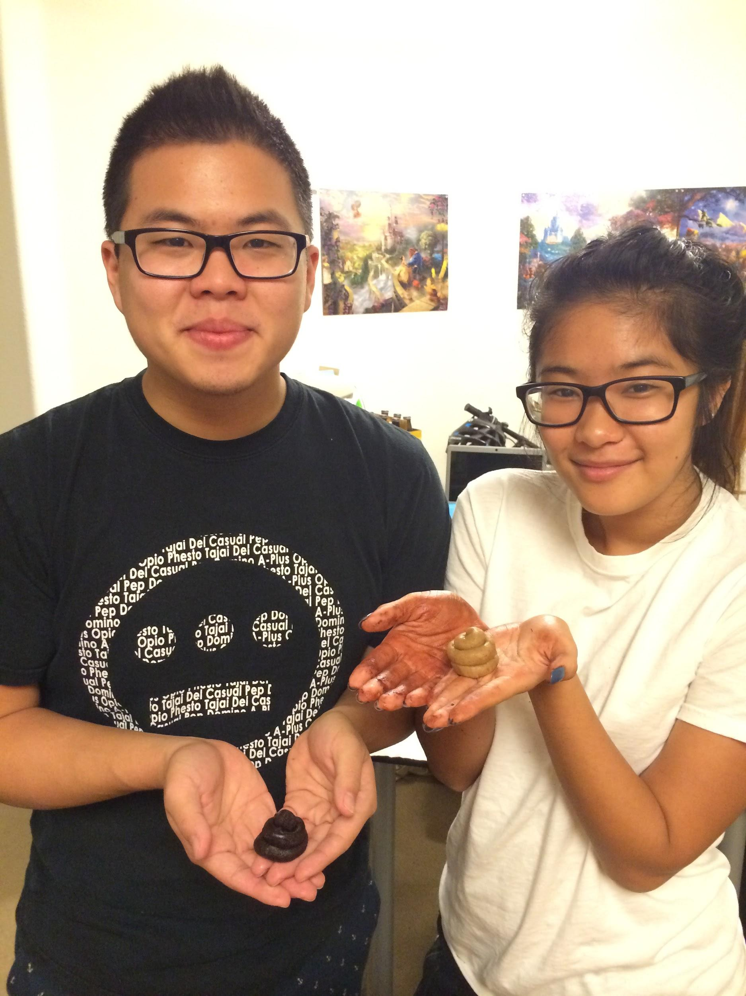
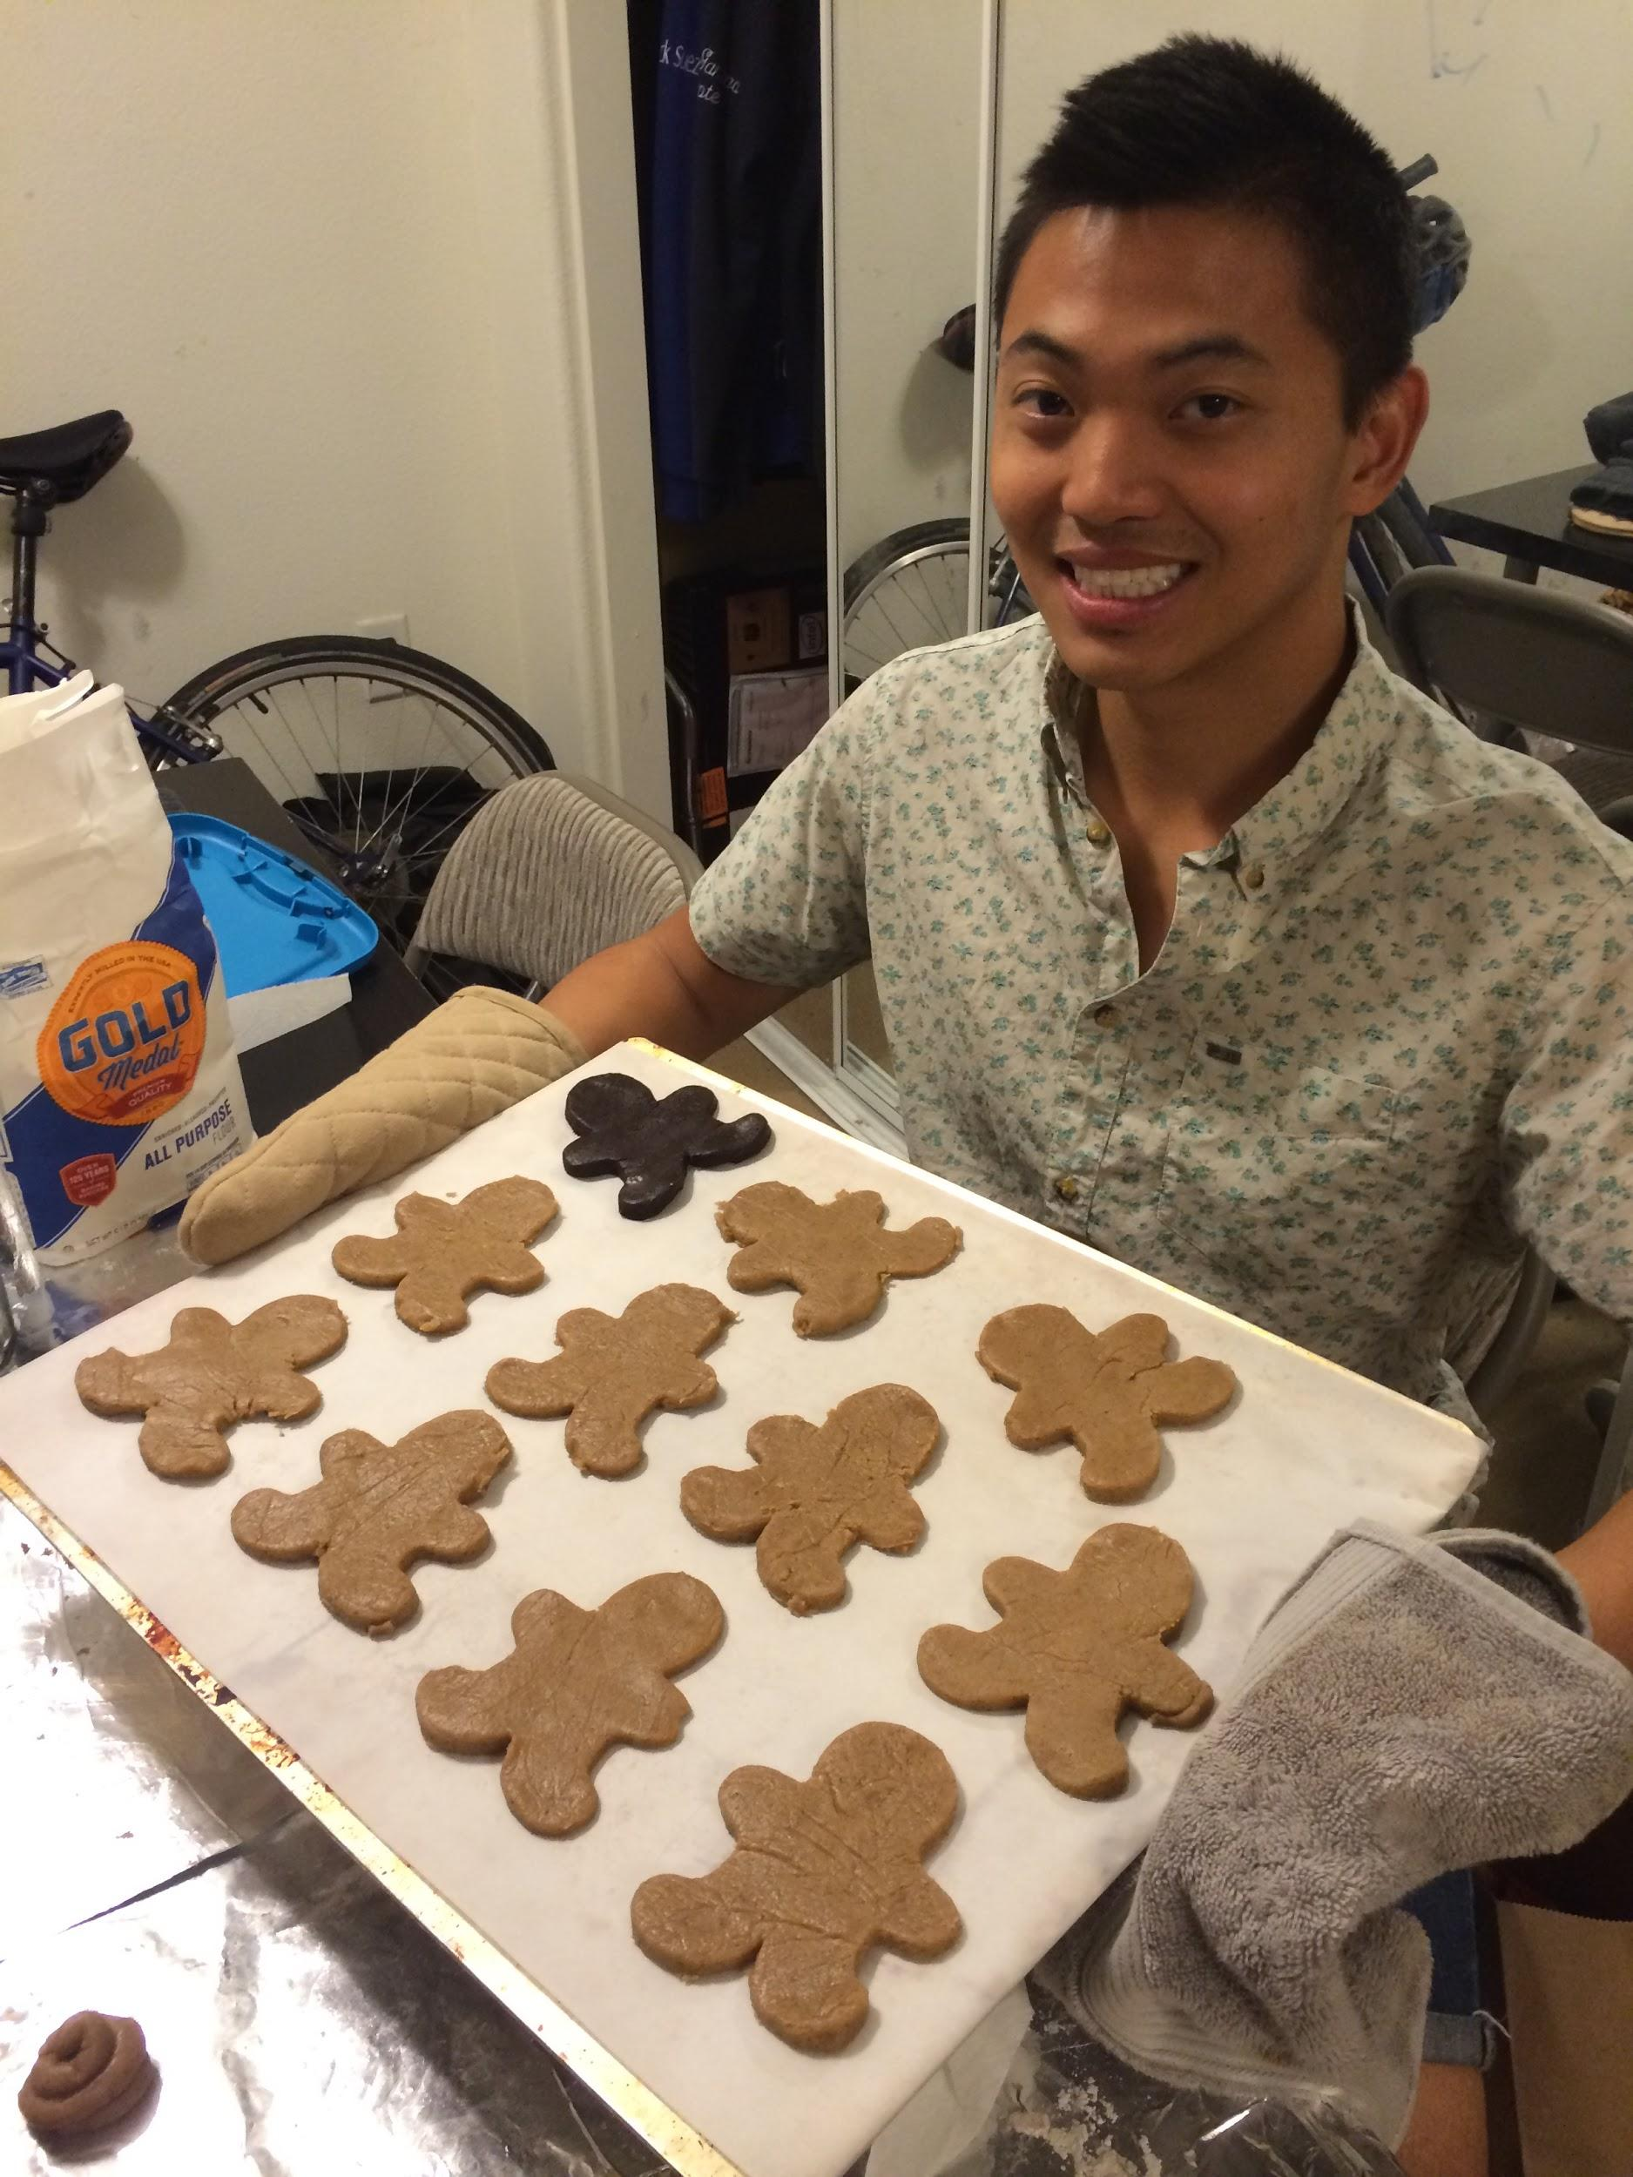
For the little sh*ts :^)
#APOdiversity

Slide 23
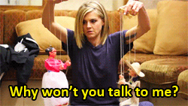
Interviews
100% of Required
Active Interviews!
Also, let us know ASAP if you wish to be removed from the Required interview list!

Slide 24

Interviews
During winter break, we will be doing another check with the Interview Tracker!
We’ll contact personally~

Slide 25

Signature sheet out!
Tis that time of year again!
You can start giving out your signature to Pledges!

Slide 26
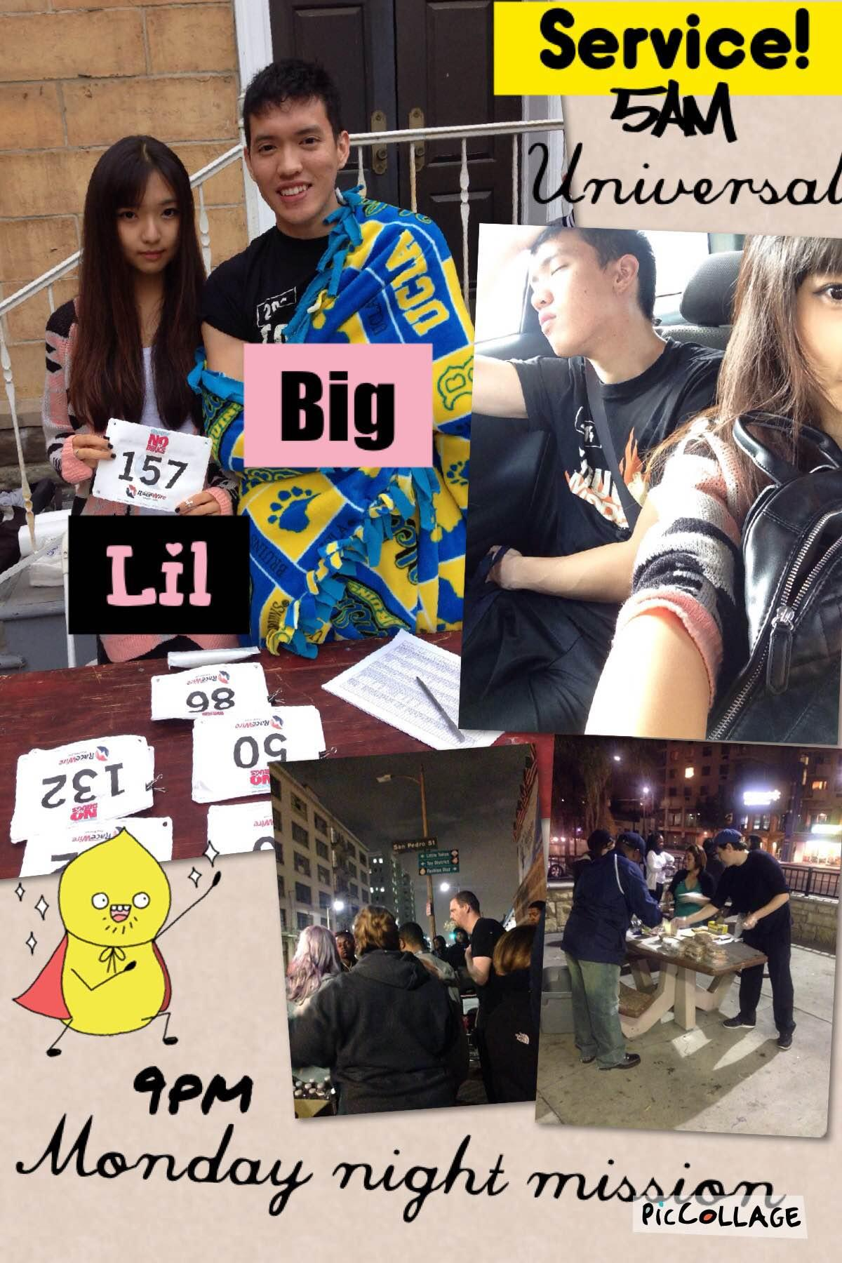
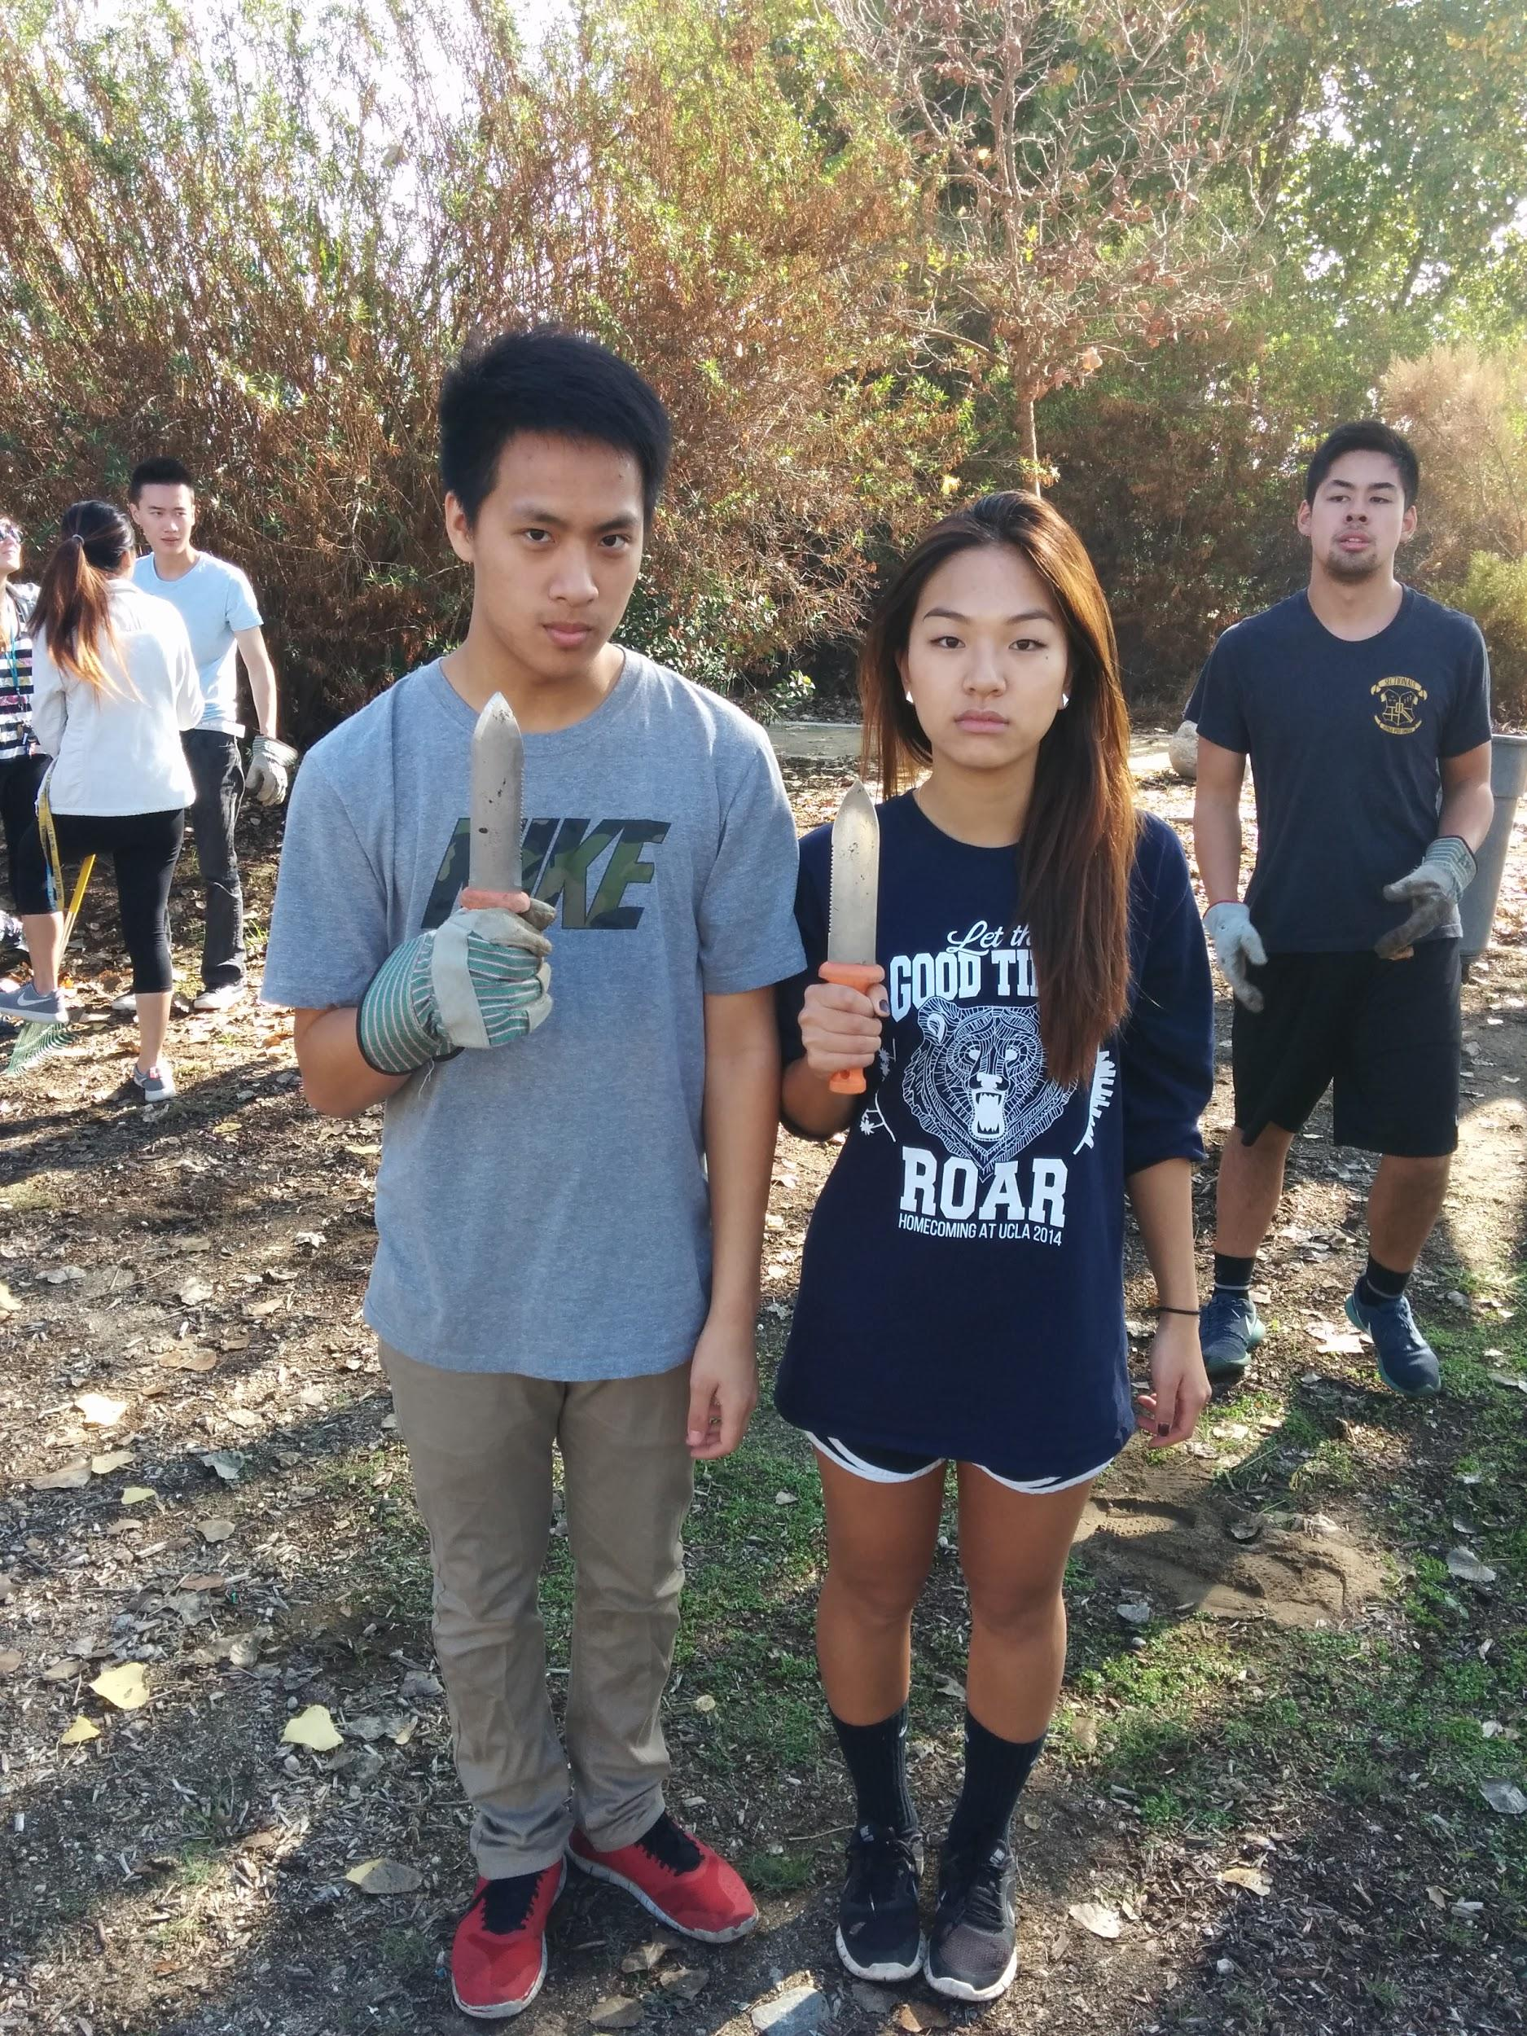
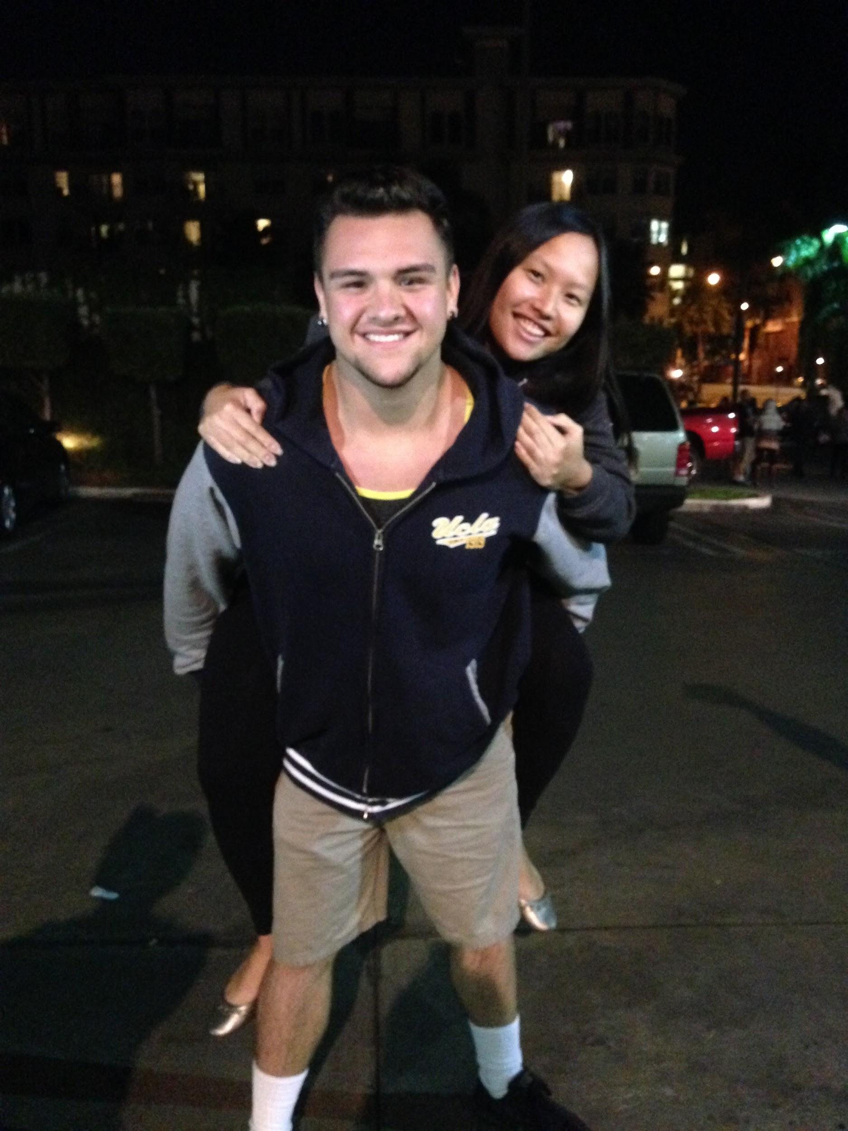
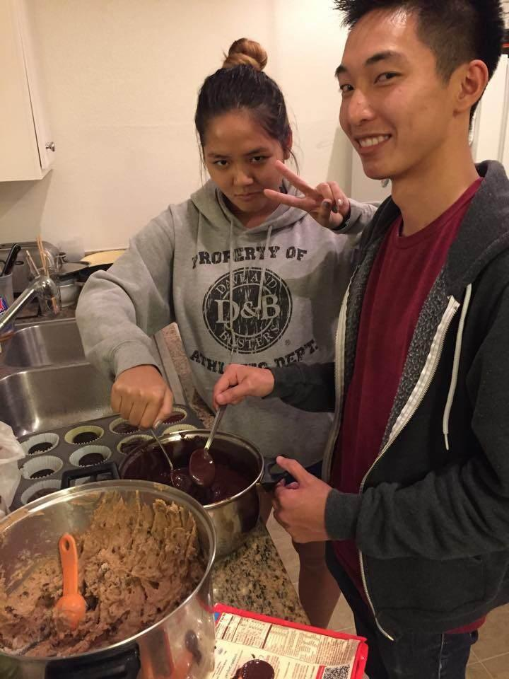
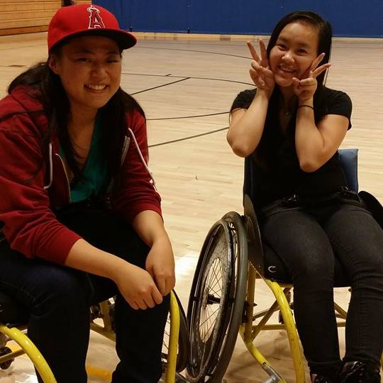
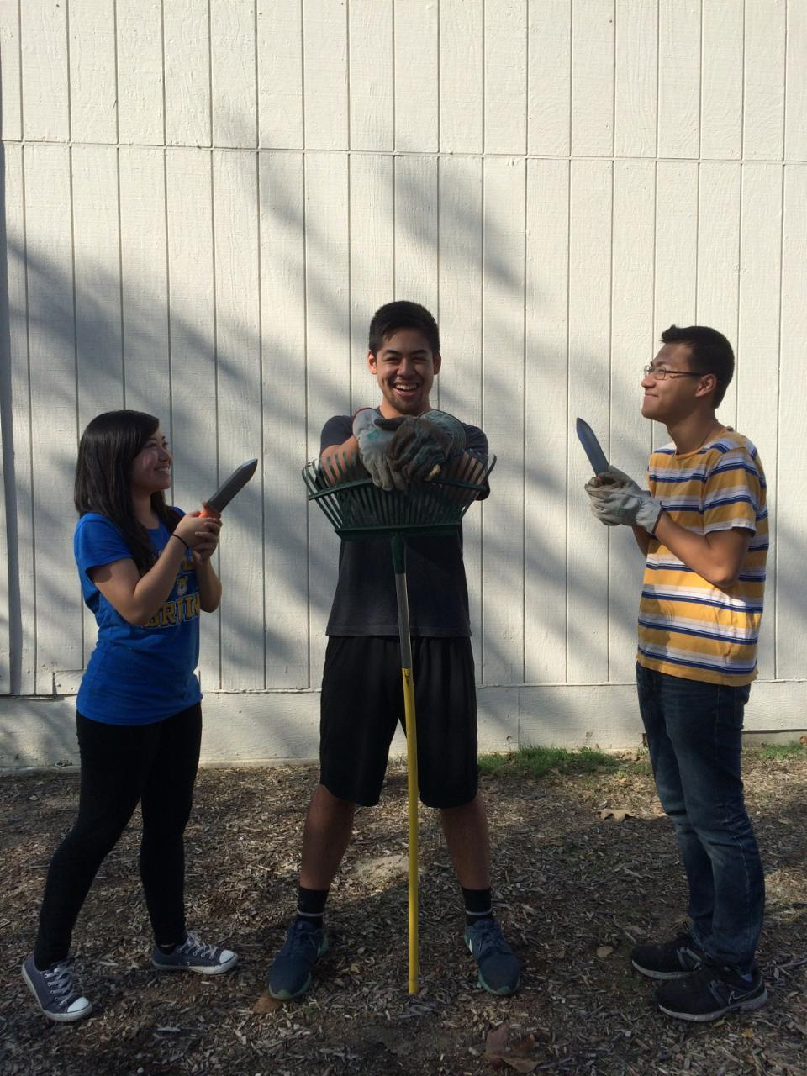
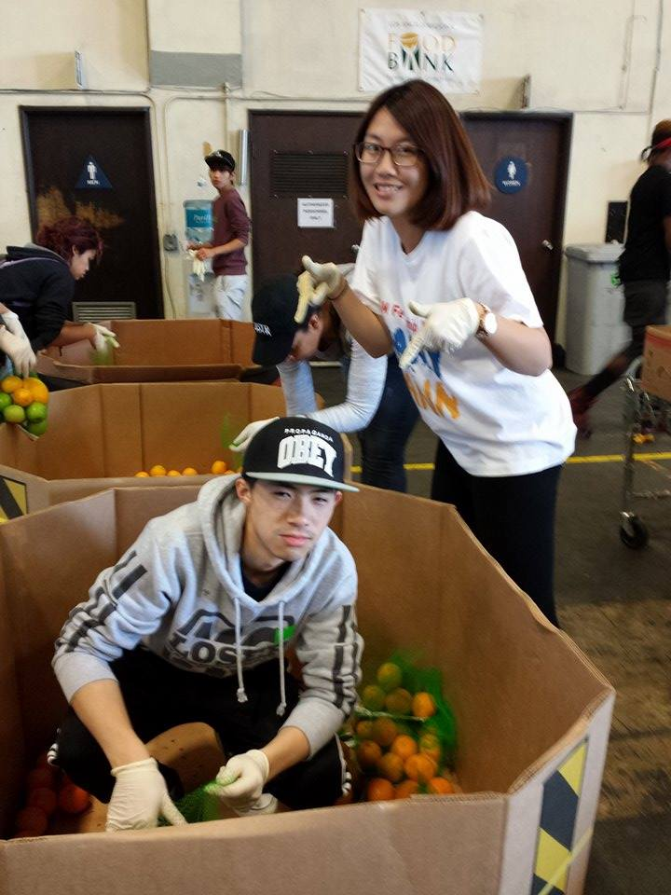
Big/Lil Service

Slide 27
Big/Lil Service
“We're both not very good at taking shots. We were on the same team for a game. Lina's proud she made an assist during the game. I'm proud that I actually made a shot during that game.”
“Although the first one was so early and the second one was kind of dangerous, I actually really liked the experiences I had and I really appreciate my big for being there with me.”
“Because of the service I think I bonded more with my big. We joked around a lot and I got to know her personality and the types of jokes she makes. I am really glad that we did service together because we get to help the community and also get to know each other better.”
“We bonded by taking out the trash, raking leaves and posing for pictures, like the ones attached, together. It was fun, I guess.”

Slide 28




Quizzes/missions
Quiz: None, maybe Jeopardy! WOO
Missions: Airband

Slide 29
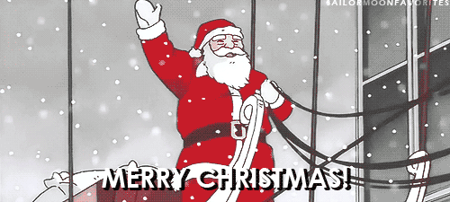
Happy Holidays!

Slide 30
Finance VPs
San Li & Jonathan Liu
finance@apo-x.org

Slide 31
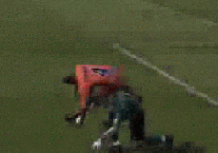
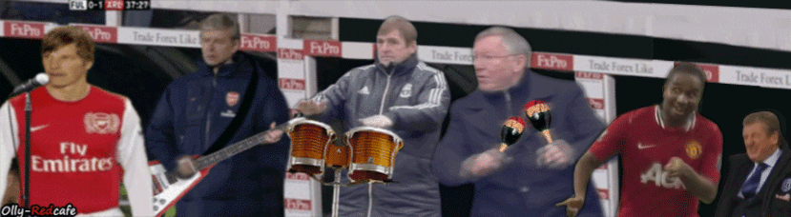
HAPPY HOLIDAYS aka FOOTBALL SEASON
Liverpool v. Manchester United - this Sunday 5:30AM

Slide 32
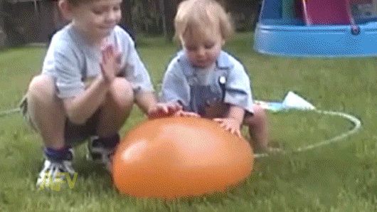
America’s Funniest Videos (12/13)
$18 per person
Dress attire
Professional
Details will be sent
out tonight!

Slide 33
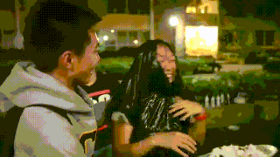
Pie Excomm! Are you Pie-Hard?
Jan. 7 after Chapter Meeting/Elections!

Slide 34
Fellowship VPs
Ann Dai & Danny Ly
fellowship@apo-x.org

Slide 35

fun foursies!
Fun Foursies Due Tonight!
Only 2 groups haven’t sent in
yet
Pls send in for credit

Slide 36

Secret santa
We sent out the pairings!
Due CM9 after Winter Break
Let us know if you didn’t
get a pairing

Slide 37
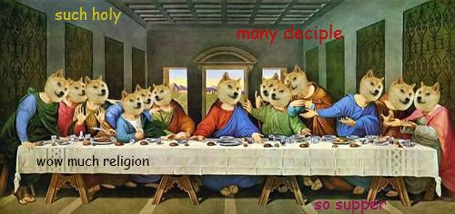
Banquet
We will have a place by this Sat
Priority = Sat > Sun > Fri
Looking for cheapest + closest

Slide 38


happy holidays!
Let us know if you want a Fellowship during Winter Break
Good luck on Finals!

Slide 39

Historian
Juana Li
historian@apo-x.org

Slide 40

Updates
-Webisode pushed back till next meeting.
-SEND ME VIDEOS OVER THE BREAK for the webisode =D
-Look out for the next Brothers of Chi Chapter picture!

Slide 41
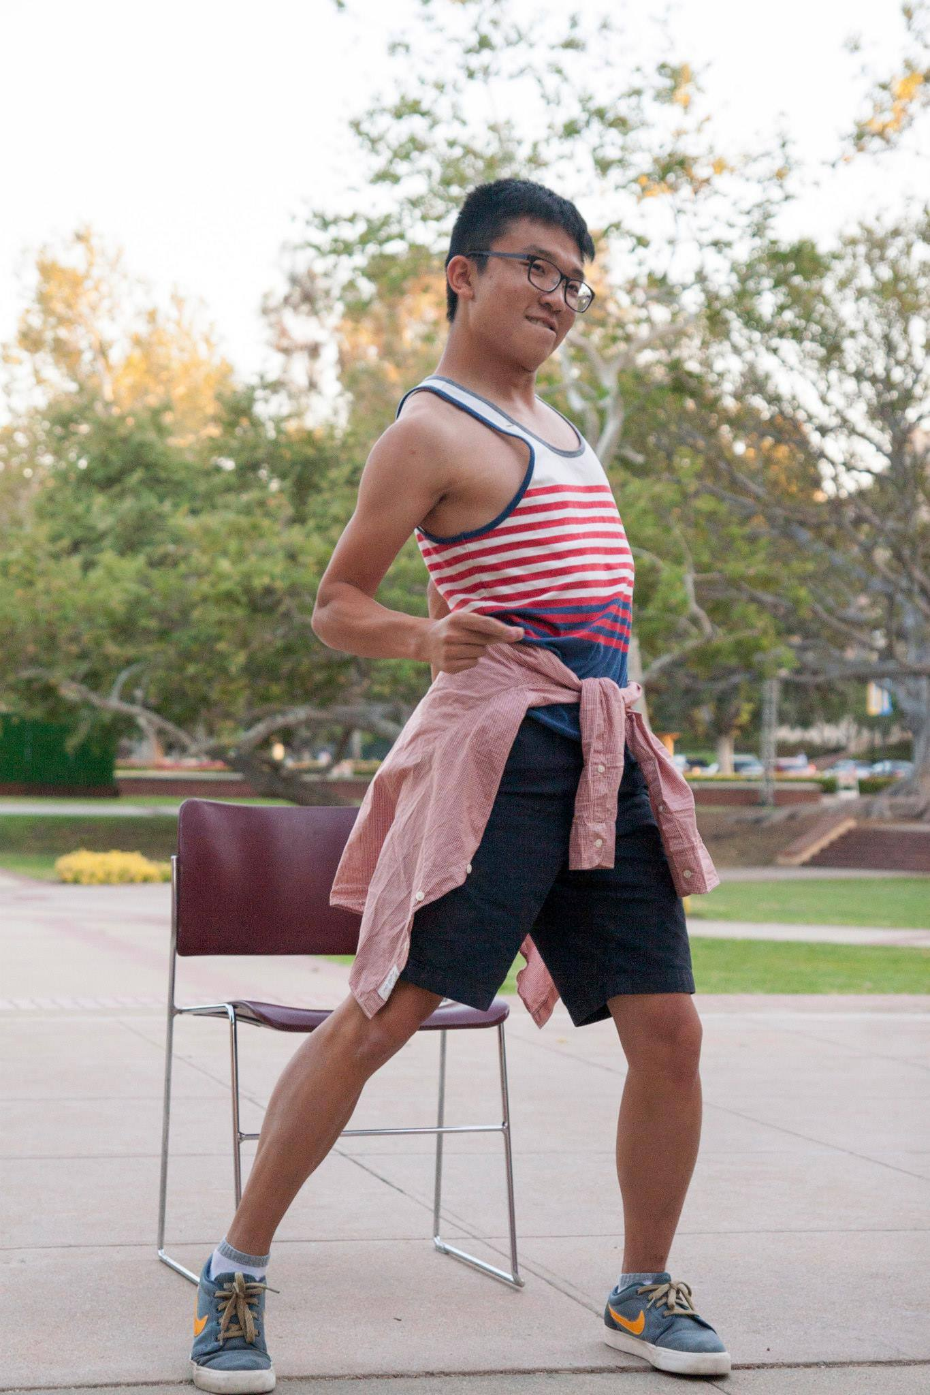

Brothers of Chi Chapter
Winner!!
Andrew Ma: “Bend and Snap!”

Slide 42
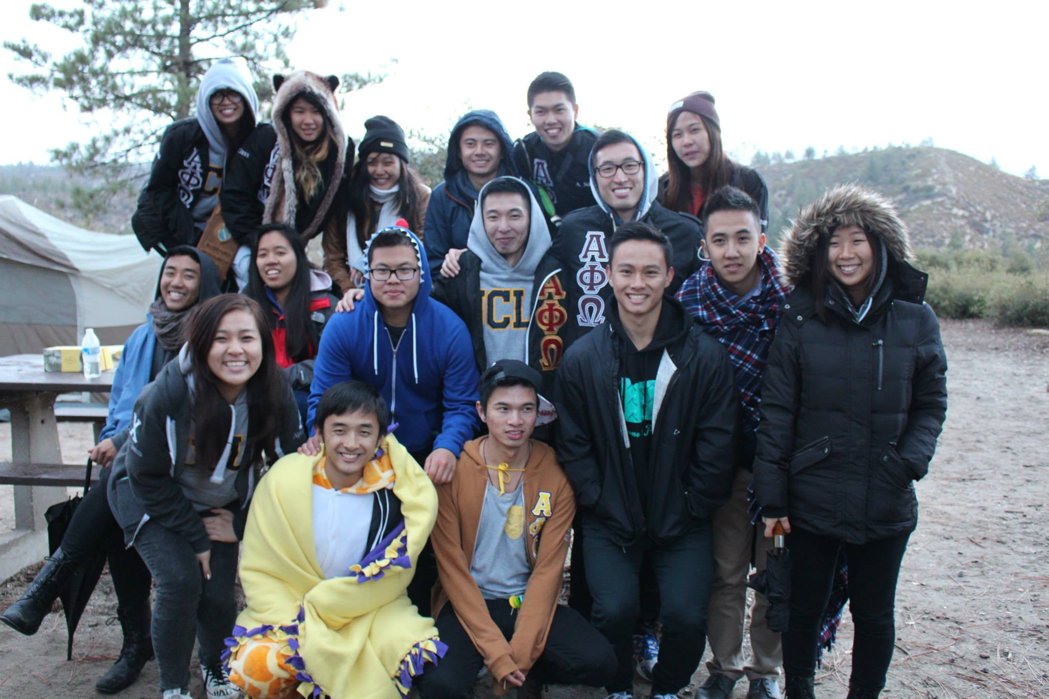
BOTW

Slide 43
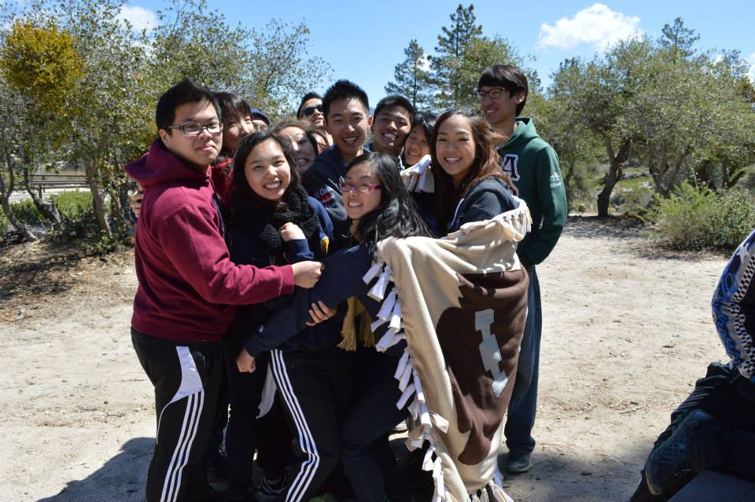

Slide 44
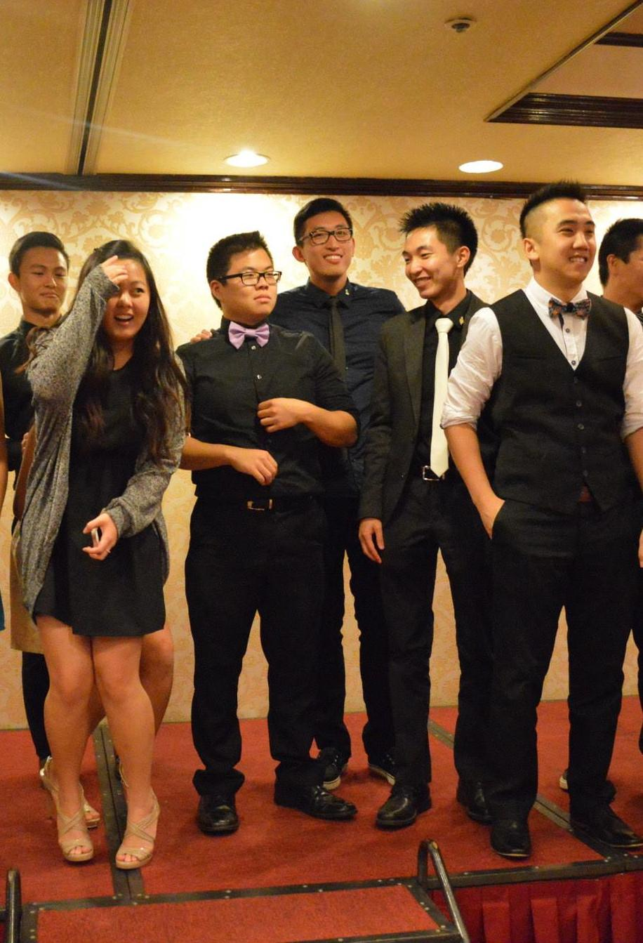

Slide 45
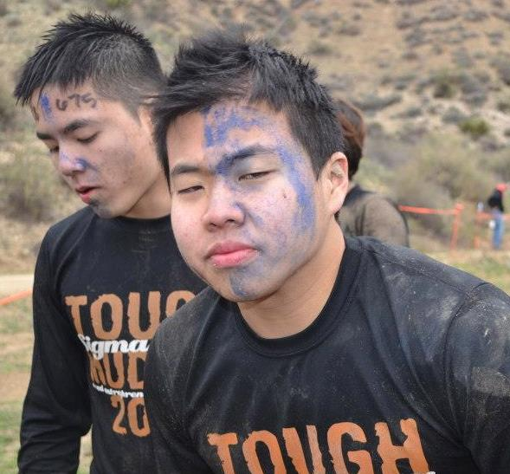
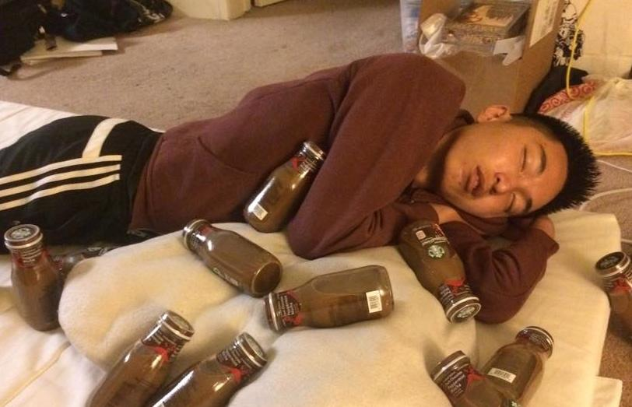
Brian Lee & San Li

Slide 46

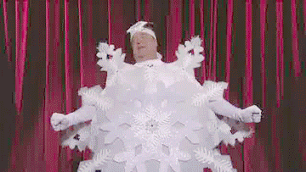
Happy Holidays!!
GOOD LUCK WITH FINALS <3

Slide 47
Sergeant-at-Arms
George Hsin
apoxsergeant@gmail.com

Slide 48

CHAIRING
MUST send in emails 3 days
prior to recieve Credit!!!
Stepping up as chair
Emails: make sure to mention that you stepped up as chair
Website: do not sign up as chair on the website
Starting now, if the above rules are not followed, you will receive a strike

Slide 49
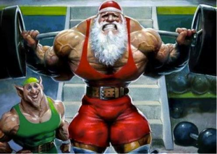
Chairing Tracker
Pledge Chairing Tracker
^{Live and up to date}
Active Chairing Tracker
^{Starting from scratch}
Will be up to date after winter break

Slide 50
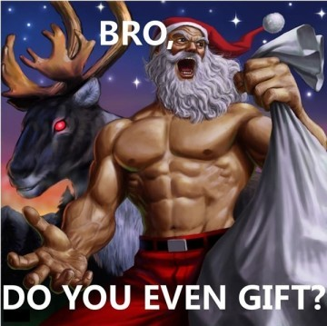
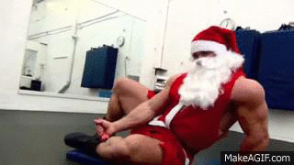
Happy Holidays!

Slide 51
Interchapter Chair
Chanel Ng
interchapter@apo-x.org

Slide 52

IC Penpal Update...
On hold because too few people from ADT signed up

Slide 53

IC Event
Sunday, 01/04 Rho Pi GBM - hangout in SD

Slide 54
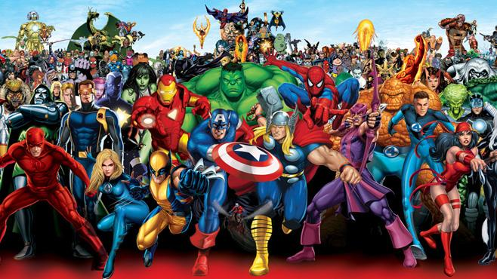
CAC
Paul Choung
cac@apo-x.org

Slide 55
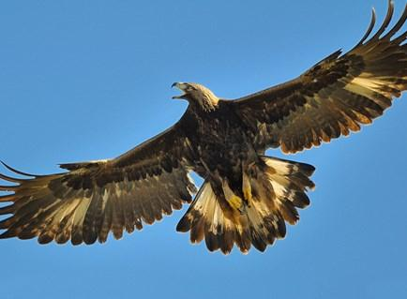
Golden Eagle Nominations
How?
Through the forum on our chapter website
http://www.apo-x.org/forums/list.php?4
or
E-mail Membership VPs
or
E-mail CAC

Slide 56

Merry Christmas, happy holidays, and good luck with your exams, from ACS. :)

Slide 57
Nominations
President
Melissa Ma
Brian Lee
Emily Neai-Proeung
Andrew Suh
Miye Nakashima
Raymond Mai
Service VP(s)
Tina Ngo

Slide 58
Nominations
Membership VP(s)
Chanel Ng & Rachel Belyea
Vivian Shih & George Hsin
Brian Lee & Emily Neai-Proeung
Pledge Parent(s)
Ann Dai & Josh Chang
Althea Alquitran & Raymond Mai
Rui Guo & Jeremy Gozzip
Jeesun Youn

Slide 59
Nominations
Administrative VP(s)
Nhat Thai & Sandra Huynh
Finance VP(s)
Sheila Wahezi & Thu Mai

Slide 60
Nominations
Fellowship VP(s)
Brian Martin & Sarah Yi
Vivian Shih & George Hsin
Nhat Thai & Sandra Huynh
Lucy Diep & Katherine Cardoza
Historian
Patricia Natalie

Slide 61
Nominations
Sergeant-at-Arms
Irene Tang
Kevin Vu
Josh Chang
George Hsin
Interchapter Chair
Bowen Lu
San Li
Althea Alquitran

Slide 62
Nominations
Chair of the Advisory Committee

Slide 63
Alpha Nu Namesake
NOMINATIONS OPEN UNTIL CM11!
ELECTIONS CM11!
Last two namesakes: Yuna Choi and Anna Lee
For those who have given a lot to CHI CHAPTER
Nominations
Winnie Banh
Andrew Ma
Kevin Lee
Paul Choung

Slide 64
Advisor Nominations
Olivia Pardo

Slide 65
Advisor Election(s)
Olivia Pardo CONGRATULATIONS OHHHH YAAAA BABYYYYYY~~~~

Slide 66
Swearing-In of Advisors
Abelard Bautista
Olivia Pardo
When we come back from winter break (CM9)
Jessica Suhardjo

